Slide 1
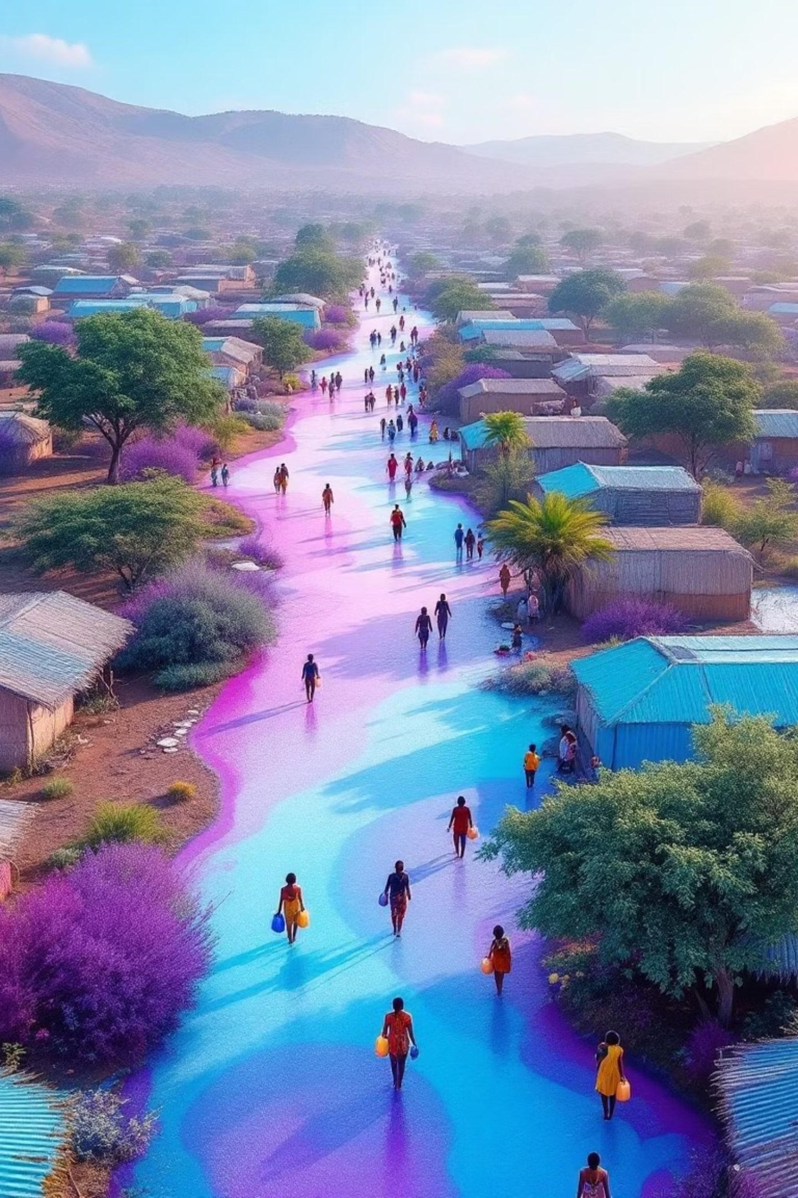
Water Access and Sanitation Conditions in Kakuma
Capstone Analysis | Python & Tableau
A comprehensive data-driven analysis of water accessibility and sanitation challenges facing one of the world's largest refugee settlements, using Python and Tableau for humanitarian insights.

Slide 2
Objectives
1
2
3
Analyze Water Access
Assess Standard Compliance
Evaluate Sanitation
Measure average distance to water sources
Map sanitation conditions throughout the camp, identifying areas with poor, moderate, and adequate sanitation infrastructure.
Evaluate household compliance with the humanitarian minimum water standard of 20 liters per person per day across different zones.
Quantify liters per person per day
Assess collection frequency and time burden

Slide 3
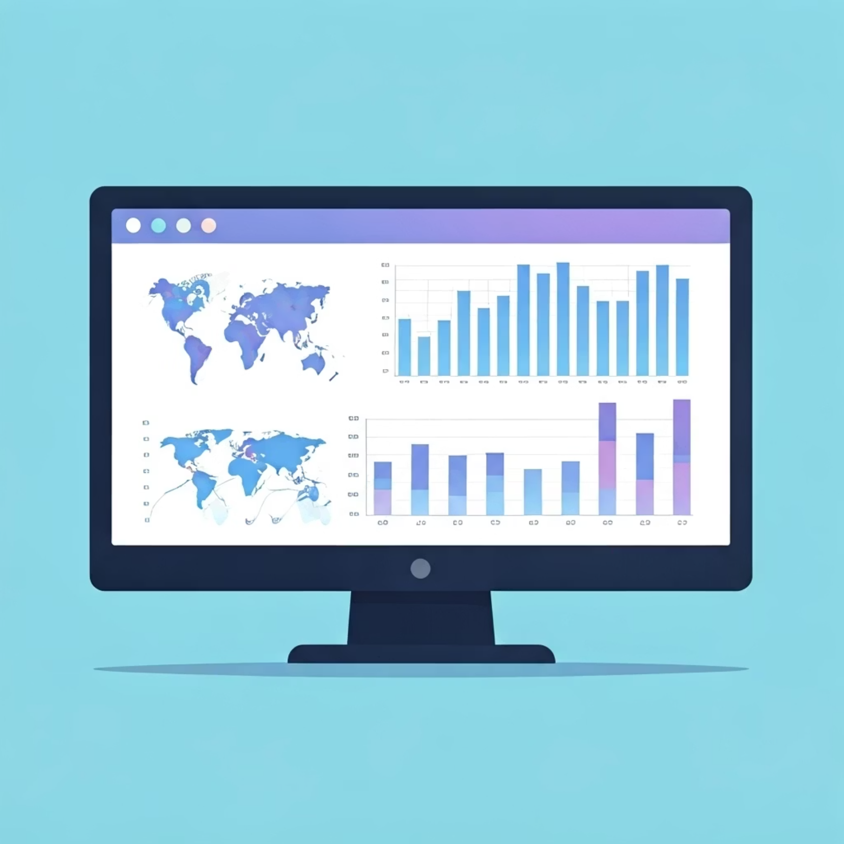




Methodology
Data Preparation
Cleaned and standardized raw data using Python (Anaconda, Pandas)
Missing Values
Categorical → 'unknown', numerical → median imputation
Feature Engineering
Created distance bins and water sufficiency flag (20L/person/day)
Aggregation
Encoded sanitation scores; grouped data by Zone for analysis

Slide 4
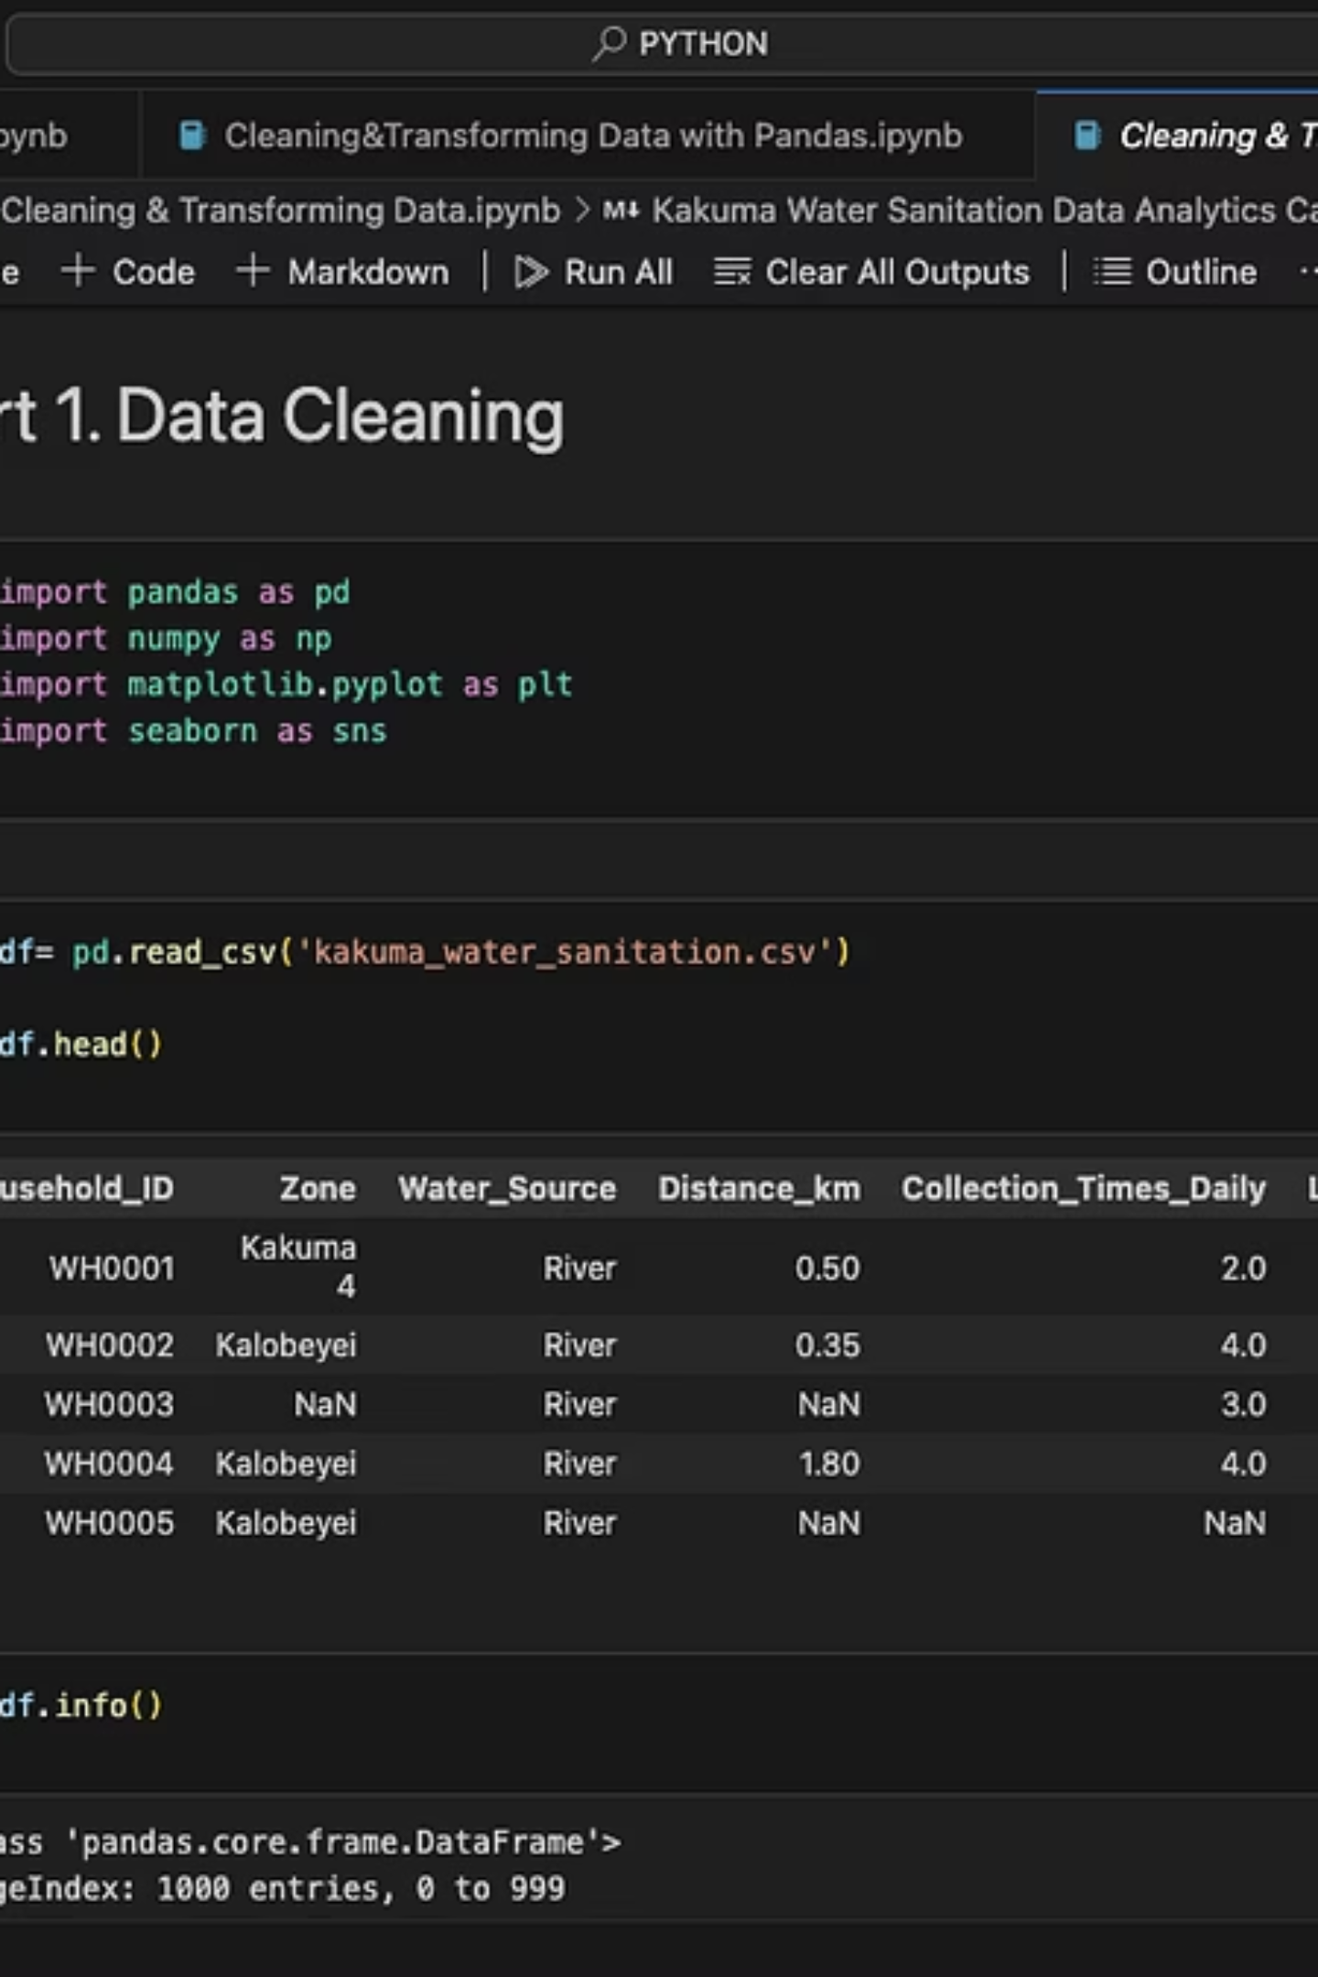
Dataset Overview
The dataset contains comprehensive household-level water access and sanitation metrics across different zones of Kakuma, enabling detailed spatial and demographic analysis of humanitarian conditions.

Slide 5
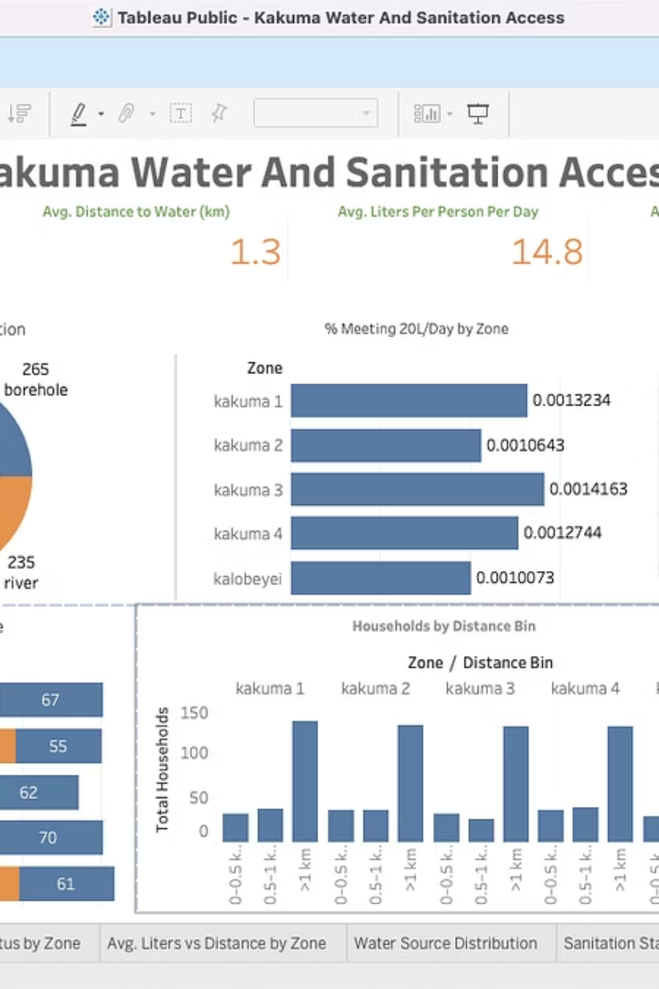
Dashboard Overview
Our interactive Tableau dashboard integrates geospatial mapping with key performance indicators, allowing humanitarian workers to identify priority intervention areas at a glance.

Slide 6
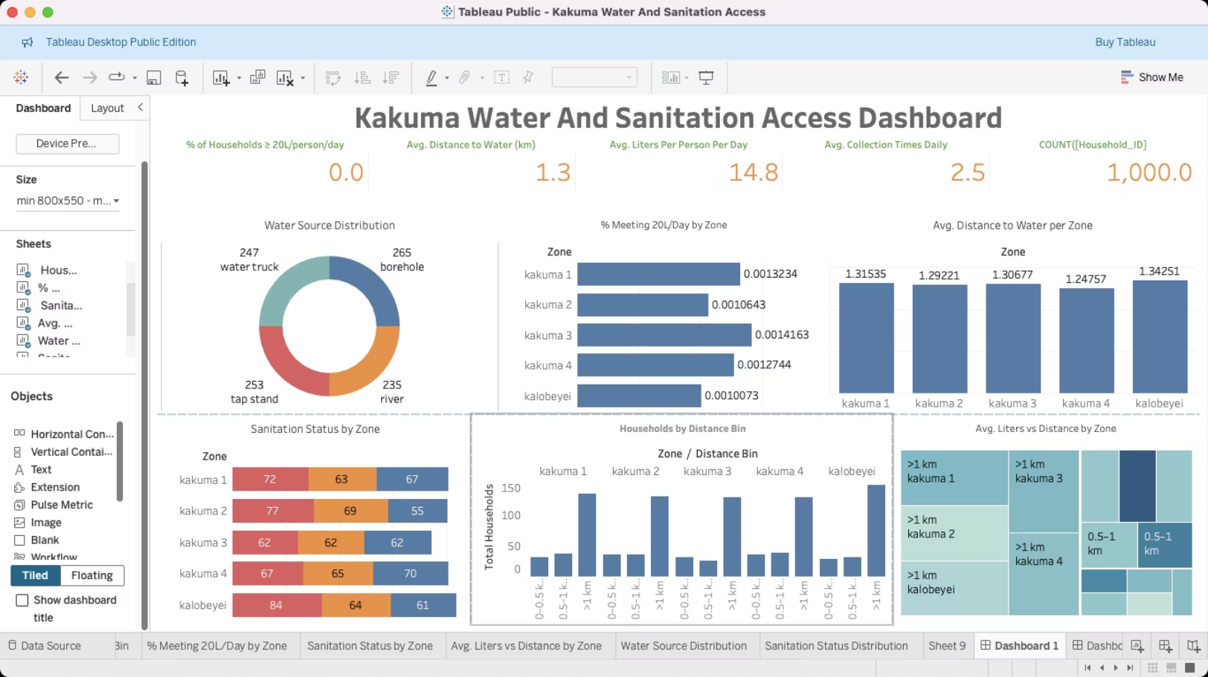
Sanitation Conditions by Zone
Our analysis revealed significant disparities in sanitation conditions across different zones:
Zones with worst sanitation scores showed alarmingly high rates of open defecation
Zone-specific patterns indicate infrastructure gaps requiring targeted interventions
Correlation between household density and sanitation deterioration

Slide 7
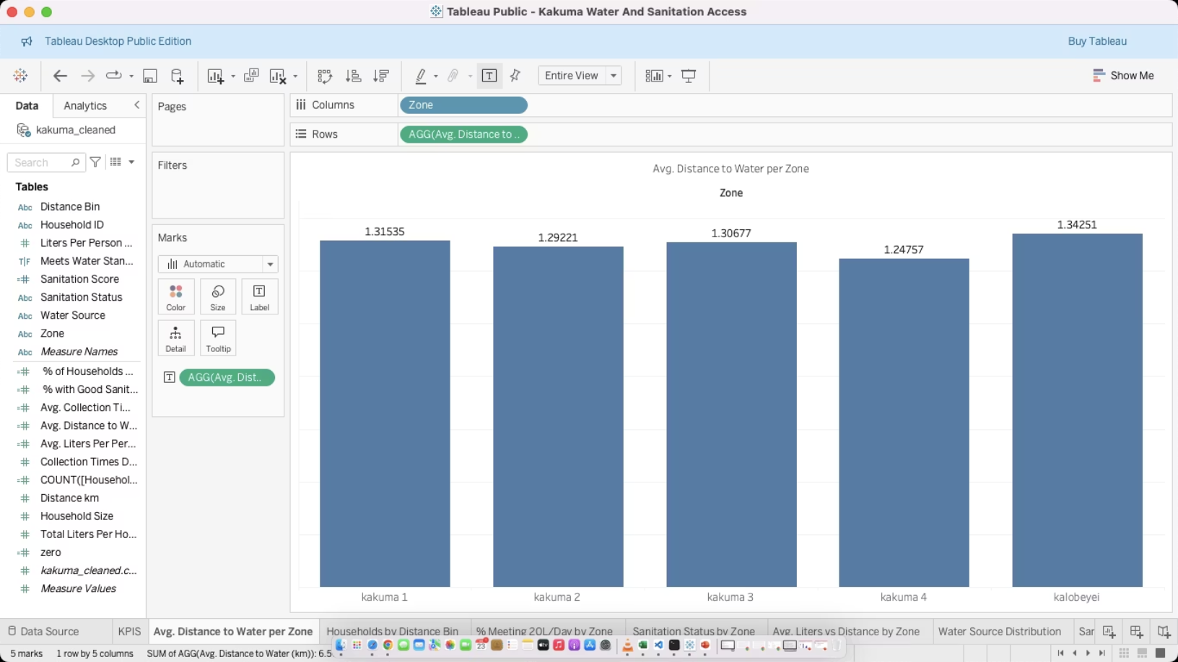
Average Water Collection Distance
1.2km
>1.3km
Overall Average
Zones Kalobeyei and Kakuma 2
Average distance residents travel to collect water
Longest average distances, exceeding WHO recommendations
3hrs
Daily Time Burden
Average time spent on water collection activities

Slide 8
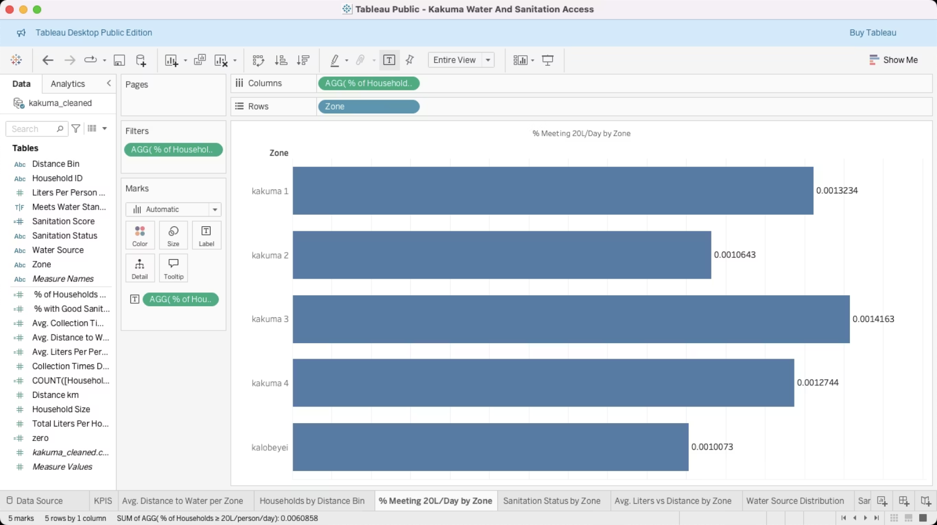

Water Sufficiency Analysis
Humanitarian Crisis: No households meeting the minimum standard of 20L/person/day
Sphere standard: 20L/person/day is the humanitarian threshold
Kalobeyei and KK2 regions have the lowest sufficiency levels
Water scarcity directly impacts health, hygiene, and cooking

Slide 9
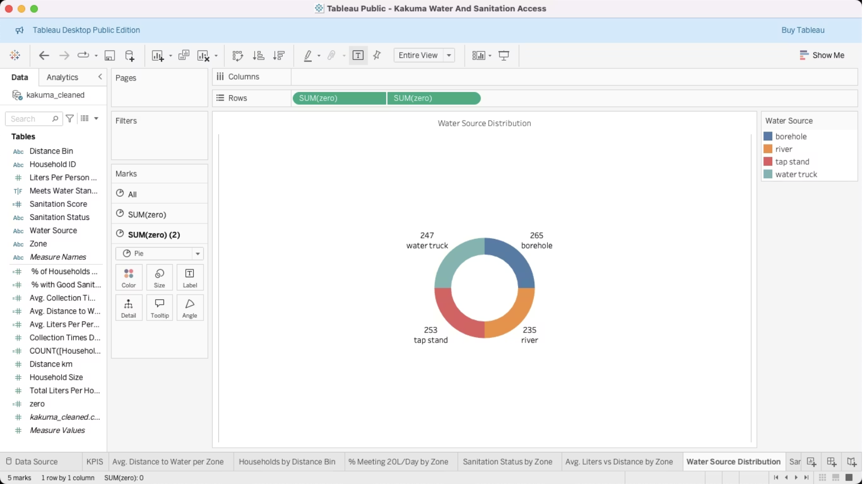
Water Source Distribution
Boreholes
Most common water source across all zones, but variable reliability and quality
Tap Stands & Water Trucks
Most efficient delivery methods, providing highest liters/person/day
Rivers & Unimproved Sources
Showed lowest liters/person/day and highest contamination risk

Slide 10
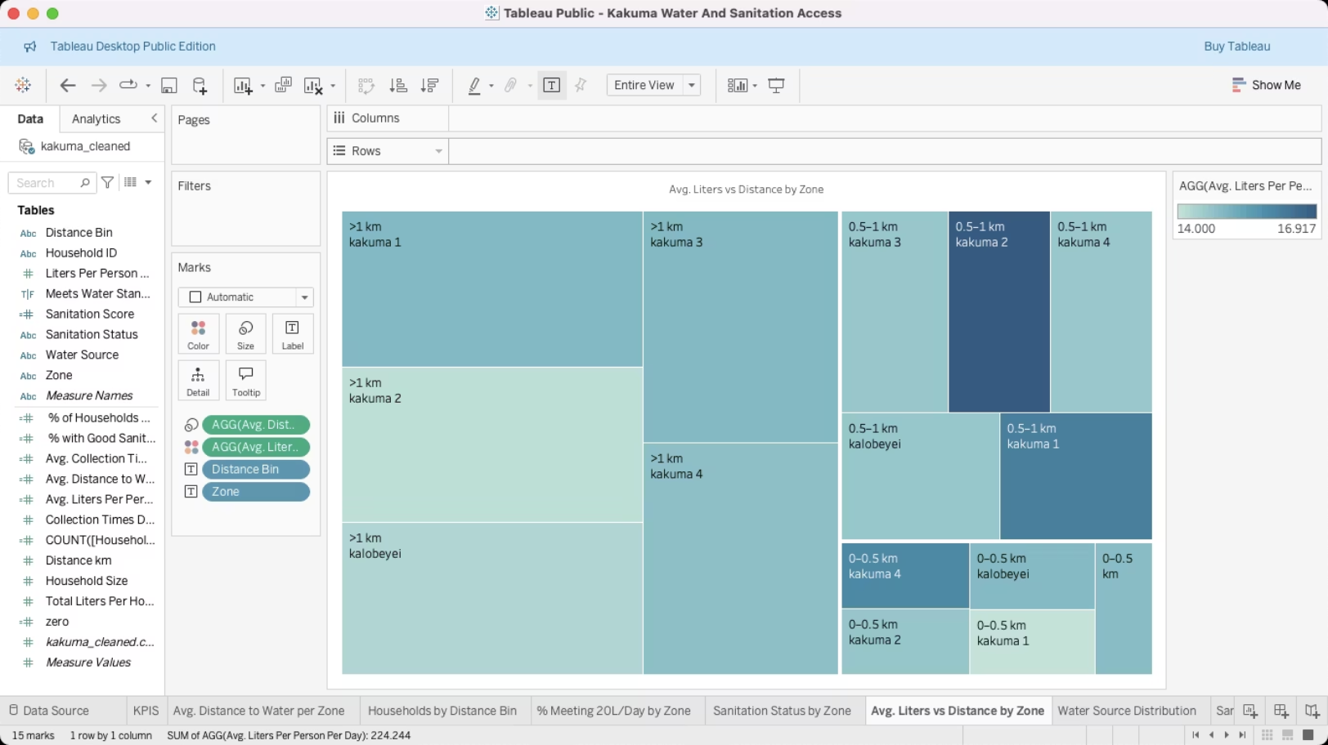

Water Access vs Sanitation
Key Findings:
Longer distances associated with lower sanitation scores
More liters/person linked with better sanitation
Better access may drive improved hygiene
Recommendation: Prioritize integrated water-sanitation interventions in kakuma1 , Kakuma 2 and Kalobeyei for maximum impact

Slide 11
Key Recommendations
Target Zones Kalobeyei, Kakuma 2, Kakuma 1 for water and sanitation interventions
Expand boreholes and piped systems to improve water stand
Promote household/shared latrines and hygiene education

Slide 12
Limitations & Future Work
Missing/incomplete sanitation data in some zones
No time series — cannot assess change over time
Future work: integrate health outcomes and trends

Slide 13
Conclusion
Marked disparities in water access and sanitation
Zones with poor access often suffer poor sanitation too
Data-driven insights can guide targeted humanitarian action

